Slide 1
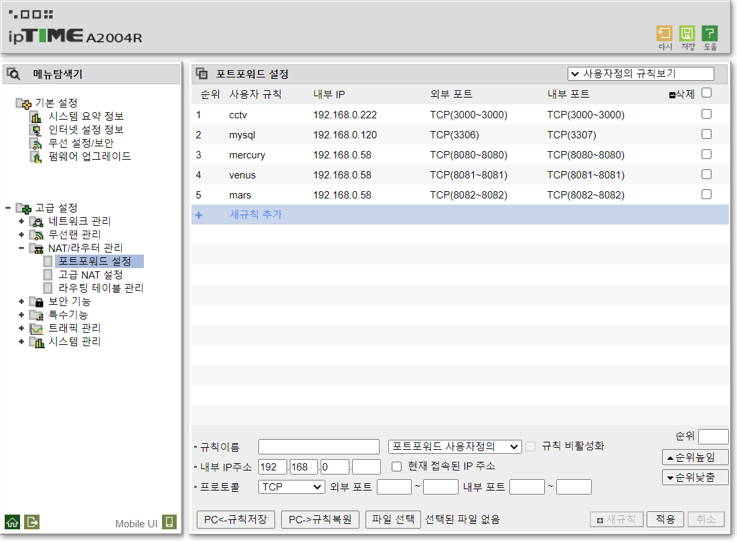

Slide 2
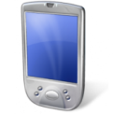






















Mobile Development Environments
Buyer
Seller & Manager
Server Environments
Web Development Environments
010011011010
100111011001
001010100011
001111010101

Slide 3
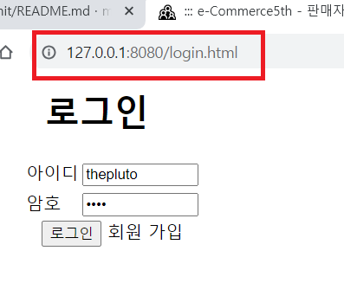
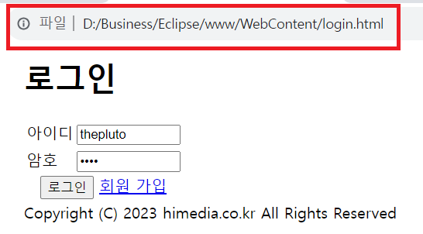

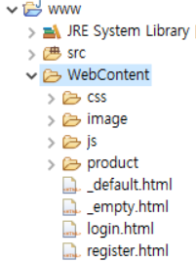







(8080)
localhost(127.0.0.1)

Slide 4
스프링 설정 에러
http://192.168.10.200/front/center/board/list.web
모델 사용 에러
1
BoardWeb.java
list.jsp
@Controller
@RequestMapping(value=“/front/center/board/list.web”)
public ModelAndView list( … ) {
…
mav.setViewName("front/center/board/.../list");
…
}
No, Title, Date
….
6
2
BoardSrvc.java
@Service
public List<BoardDto> list( … ) {
…
}
TB_BBS
쿼리 에러 또는 오류
3
5
BoardDao.java
Board.xml
@Repository
public List<BoardDto> list( … ) {
…
}
<select id=“list” parameterType=“boardDto” resultType=“boardDto”>
…
</select>
4

Slide 5
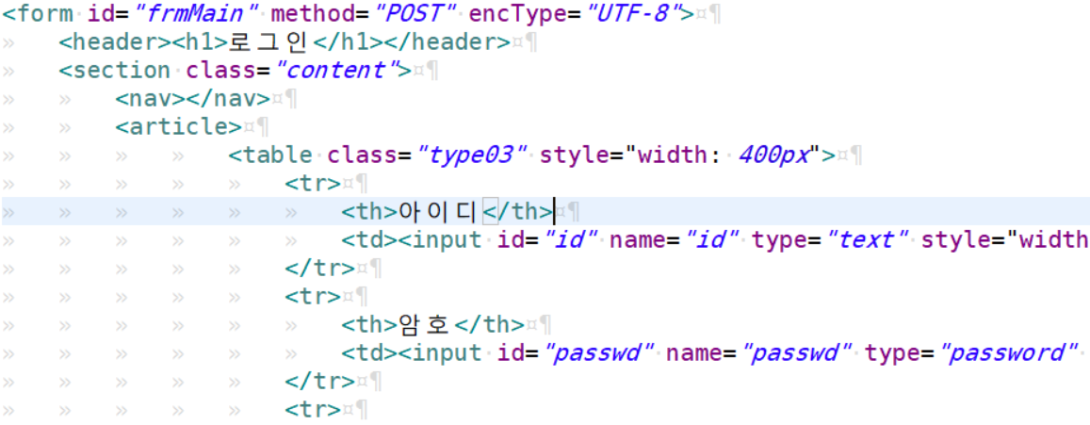
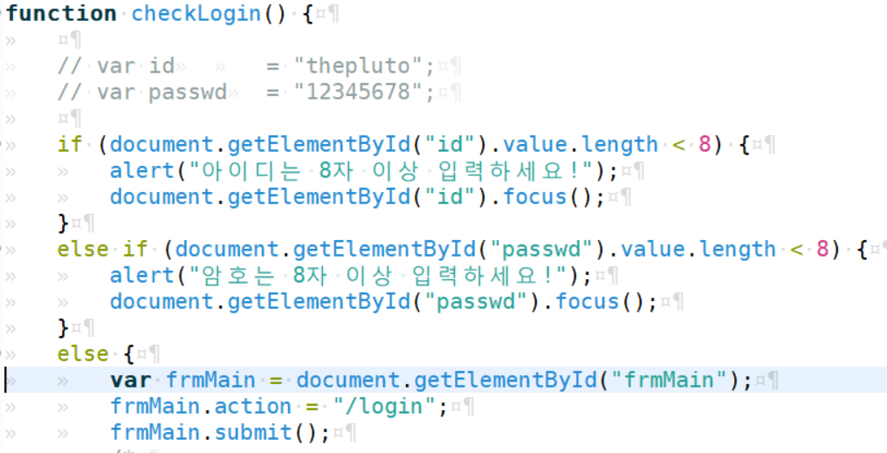
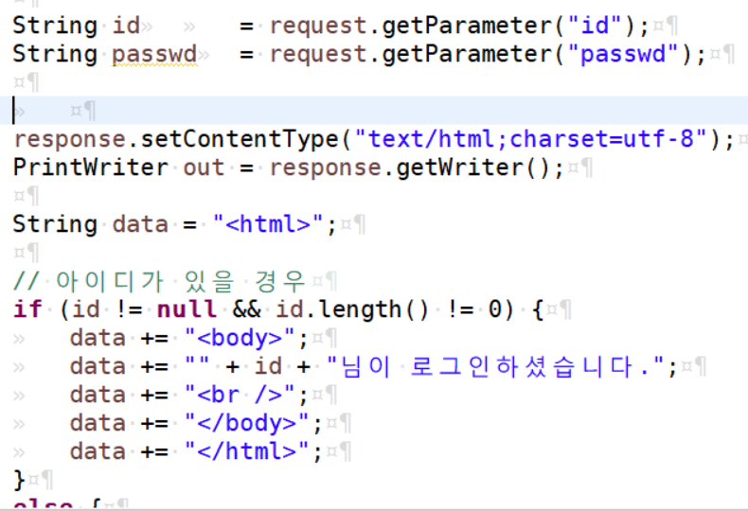

Slide 6
